Slide 1
Mid Term Defense on Code Connect: Connect with Creatives
BCA : Project I
Faculty of Humanities and Social Sciences,TU
Name | Roll no:
Amit Maharjan | LEC077BCA01
Sushant Bramhacharya | LEC077BCA08
Date : 2023/08/23
Submitted To:
Department of Computer
Lalitpur Engineering College
Chakupat, Lalitpur

Slide 2
Introduction
What is Code Connect?

Slide 3
Motivation
Exposure for Newcomers
Community Building
Knowledge Sharing and Learning
Personal Growth and Challenge

Slide 4
Problem Statement
Lack of specific social media for IT enthusiast
Limited Facilities for sharing Resume and Projects
Limited Exposure in other social media
Specially for new aspiring developers and designers

Slide 5
Objectives
To develop a user-friendly social media web app specifically tailored to IT enthusiast.

Slide 6
Scope
Discussion/ Collaboration
Messaging
Showcase
Connection

Slide 7
Originality
Specialized Platform
Career Enhancement
Empowerment and Growth

Slide 8
Background
The project was conceptualized based on personal experiences.
Through discussions and research, it became evident that existing social media platforms lack on our needs.
The project aims to address this gap by creating a dedicated space for IT enthusiast.

Slide 9
Literature Review
Social networks are like groups of people who know each other and interact with each other.[1]
LinkedIn is the preferred social media platform for recruiters, while Twitter and Facebook are less.[2]
Complete profiles in Stack Overflow lead to better quality posts.[3]

Slide 10
Contd..
Higher Reputation means Higher Exposure.[4]
GitHub Discussions faces challenges due to topic duplication with Issues, leading to confusion and redundancy.[5]
Ajax enables seamless, asynchronous server requests from the client-side, enhancing webpage performance and user experience by updating specific parts without full reloads. [6]

Slide 11
Functional Requirements
User Registration/Login
User Profile Management
Connection Management
Discussion/News Feed
Messaging
Notifications

Slide 12
Non Functional Requirements
Performance
Authentication Security
Better UX design
Responsive Site

Slide 13

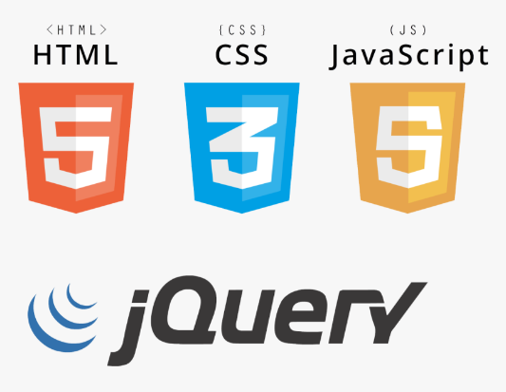



Implementation
VCS : Git
Design : Figma
Repository Management : GitHub
Frontend : HTML, CSS, JS
Database : MySQL
Modules : AJAX and JQuery
Backend : PHP

Slide 14
Testing: Unit Testing
Tests | Test Cases | Input | Output
1 | Incorrect Password | Email:test@gmail.com Password:1234 | Incorrect Password
2 | Incorrect Confirm Password in SignUp | Email:test@gmail.com Password:12345679 Password:12345678 | Enter Same Password
3 | Correct Credentials In Login | Email:test@gmail.com Password:12345679 | Redirects to homepage

Slide 15
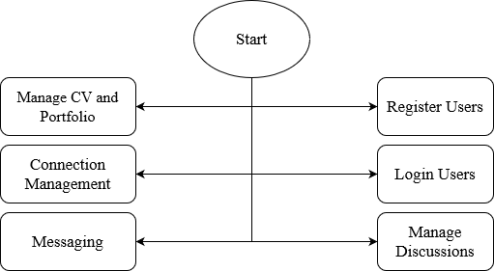
System Design (Architecture)

Slide 16
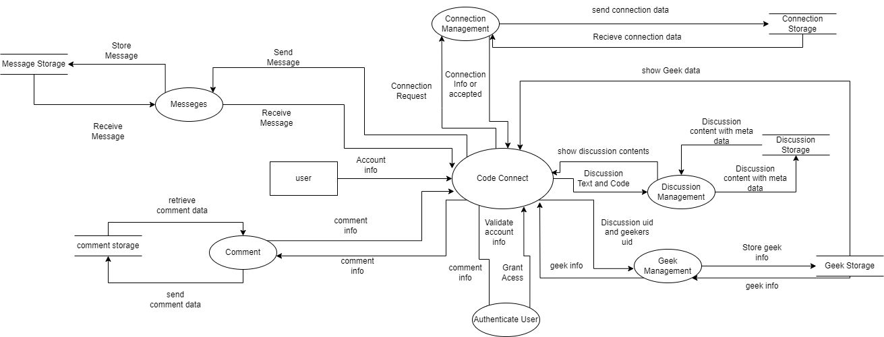
Physical DFD

Slide 17
Work Completed
Home Page
Geek/Un-Geek
Profile
Messenger
Search

Slide 18
Contd..
Connection Management
Notification
Discussion

Slide 19
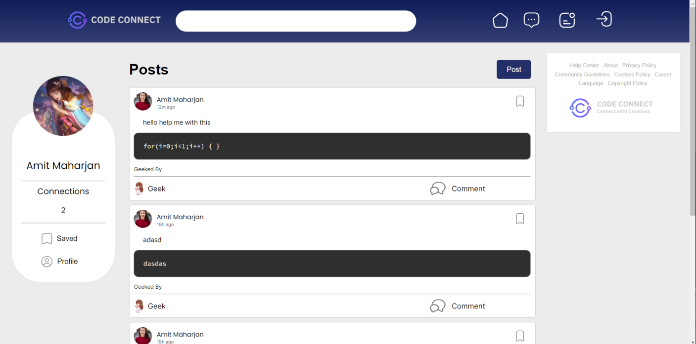
Outcomes:

Slide 20
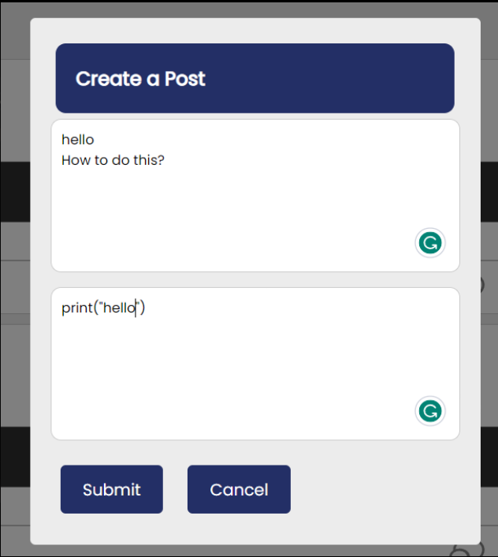
Contd..

Slide 21
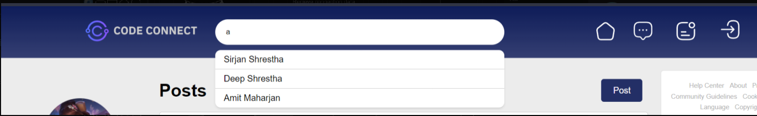
Contd..

Slide 22
Works Remaining
Comments
Messenger
Search for Codes/Discussion
CV Upload and Management
Portfolio management

Slide 23
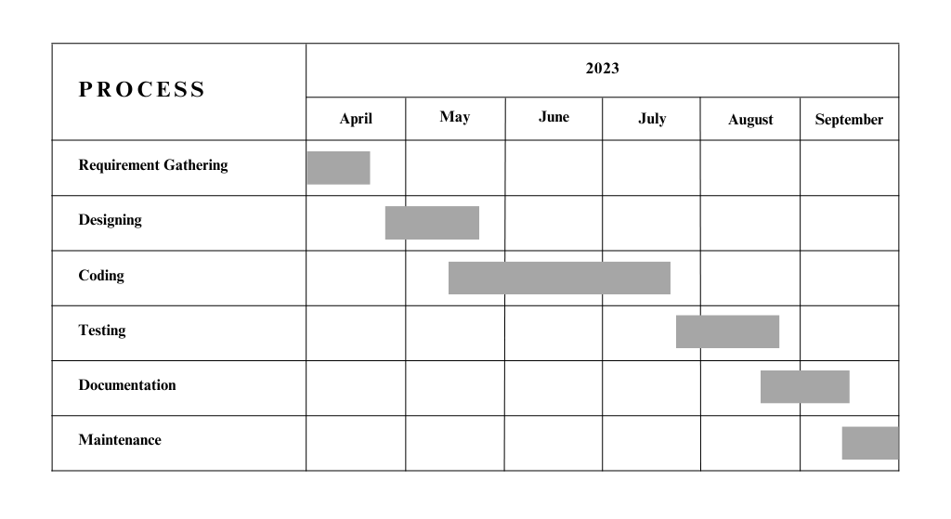
Timeline

Slide 24
References
[1] Anton Korshunov, Ivan Beloborodov, Nazar Buzun, Valeriy Avanesov, Roman Pastukhov, Kyrylo Chykhradze, Ilya Kozlov, Andrey Gomzin, Ivan Andrianov, Andrey Sysoev, et al. Social network analysis: methods and applications. Proceedings of the Institute for System Programming of the RAS (Proceedings of ISP RAS), 26(1):439–456, 2014.
[2] Tanja Koch, Charlene Gerber, and Jeremias J De Klerk. The impact of social media on recruitment: Are you linkedin? SA Journal of Human Resource Management, 16(1):1–14, 2018.
[3] Ifeoma Adaji and Julita Vassileva. Towards understanding user participation in stack overflow using profile data. In Social Informatics: 8th International Conference, SocInfo 2016, Bellevue, WA, USA, November 11-14, 2016, Proceedings, Part II 8, pages 3–13. Springer, 2016.
[4] Dorota Celinska. Coding together in a social network: collaboration among ´ github users. In Proceedings of the 9th international conference on social media and society, pages 31–40, 2018.
[5] Hideaki Hata, Nicole Novielli, Sebastian Baltes, Raula Gaikovina Kula, and Christoph Treude. Github discussions: An exploratory study of early adoption. Empirical Software Engineering, 27:1–32, 2022.
[6] Jose Rolando Guay Paz and Jos ́ e Rolando Guay Paz. Ajax and jquery. ́ Beginning
ASP. NET MVC 4, pages 111–138, 2013.

Slide 25
Thank You

